Slide 1

Sprint 2 - Retrospective
Team Lead: Brayden Chumbley
Team Members: Jerritt Hung, Carter Neeb, Eddie Bhandari, Talha Sadaqat, Noah Guta, Ryan Grace

Slide 2
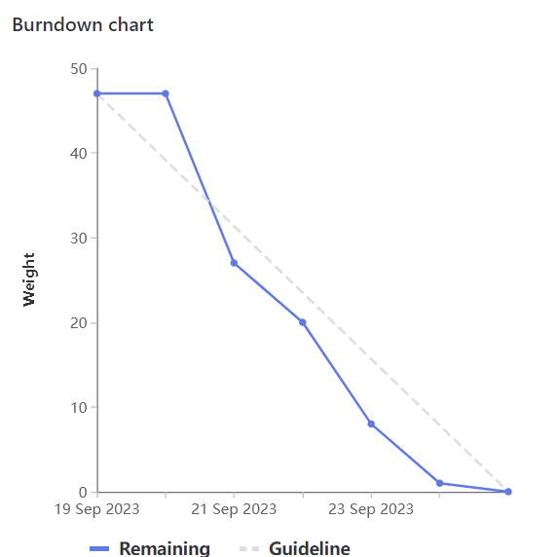
Sprint Summary
Overall, sprint went well!
Implemented Features
Updated parser
Excel VBA Course Recommendation program

Slide 3
Sprint 1 – Successes
Deliverables
Finished all deliverables before Saturday night
Allowed a day of testing and debugging
Timely
Was on track or ahead of schedule for majority of the sprint
Finished issues according to sprint priority

Slide 4
Sprint 1 - Struggles
Slow start to sprint
No tasks closed first day of the sprint
Strong second day of work got us back on track
Correcting parser from last sprint resulted in undesirable delay
VBA work could not begin until prerequisite courses were parsed correctly
Hours of man time lost meant we were rushed on the VBA portion
Parser in much better state for continued improvements

Slide 5
Brayden – Accomplishments (20 Weights)
Led Tuesday and Thursday sprint meetings
Pair programmed with Jerritt to modify parser to recursively parse course prerequisites
Tested updated parser and VBA application
Retroactively commented code to ensure future maintainability of codebase
Updated project documentation in README.md

Slide 6
Jerritt – Accomplishments (21 Weights)
Pair programmed with Brayden to modify prerequisites parser to export parsed prerequisites in VBA readable format
'Simple' prerequisites (x or y; x, y, z; x of y, z)
'Complex' prerequisites (brackets, nesting)
Fixed most prerequisites parsing edge cases both alone and with Eddie and Ryan
Small bug fixes
Worked with Eddie and Ryan to add ability for spreadsheet to process prerequisites of format 'x credits including y'

Slide 7
Carter – Accomplishments (23 Weights)
Pair programmed with Ryan to complete the recursive pre-requisite evaluation of complicated pre-requisites, ex. 2 (1 courseA courseB) (1 courseC courseD)
Created VBA UI to ask user for desired semester and verification on said input
Created initial RegEx for parsing or statements into new readable format in CSV (paired with Talha)
Various small bug fixes (both by myself and in pairs)
Pair programmed with Talha to parse credit requirements in CSV

Slide 8
Eddie – Accomplishments (20 Weights)
VBA Course Planner(12 weights; spread across issues)
(Paired primarily with Noah; Ryan, Talha and Jerrit as well)
1 – Set up - Reading user input, necessary buttons
2 - Validation:
Simple 'and' + 1 course prerequisite
Simple 'X of'
"Including"
Challenge – No mac support for VBA, paired through taking control via teams w/Noah. Limited commits due to this, proof of contribution via team survey or call logs.
Python Parser(1 weight)
Parsing of simple "and" into prerequisite cells
Project Wiki (1 weight) - Sprint 1 + Sprint 2
Meetings(Sprint Plan=3, Check In 1=1, Check in 2=2)

Slide 9
Talha – Accomplishments (20 Weights)
Joined with Ryan to make sure parsing works as intended for more complex prereq strings and for some more of the edge cases
Worked alongside Carter for initial RegEx for parsing or statements into new readable format
Pair programmed with Noah on some parts for Python parsing , figuring out regex statements for some complex parsing issues
Collaborated with Ryan , Eddie and Noah for VBA course planner and to process simple prereqs into separate cells , and figured out some limitation and challenges we were facing
Took care of the meeting notes
Attended Initial Sprint meetings , check in meetings and kept up with the workflow on discord

Slide 10
Noah – Accomplishments (20 Weights)
Pair Programmed with Jerritt on the Python Parser (4 Weight spread across issues)
Processed "simple or" + "simple and" prerequisites
Swap prereq raw string with parsed prereqs
Eddie, Ryan and Talha joined during parts for additional support
Pair Programmed with Eddie on VBA Course Planner (12 Weight spread across issues)
Initial set up: read and tested user input, read through course list and split based on prereq type, highlighting courses user can take and necessary buttons
Added validation for:
1 course prereqs
"simple and" prereqs
"simple x of" prereqs
Talha joined during the first session for additional support as well
Meetings (Sprint Planning = 3 Weight, Check-In 1 = 1 Weight)

Slide 11
Ryan – Accomplishments (20 Weights)
Pair programmed with Jerrit and Eddie to implement support to process prerequisites of format "x credits including y"
Pair programmed with Carter to implement a recursive function that evaluates complex prerequisites in VBA
Meetings, including initial, one and two
Pair programmed with Jerrit and Talha to fix edge cases
Processed simple "and" prerequisites into separate cells
Paired with Noah, Eddie, Tahla, Jerrit
Challenge: Like Eddie, almost no VBA support on Mac, therefore limited commits.
Proof of contribution via teams survey, call logs, discord chat

Slide 12
Demo

